Slide 1


Group 5

Slide 2

What is Go Nuts?
A competitive, networked multiplayer racing game for 3-5 players
Simultaneous, symmetric gameplay
PC standalone, keyboard & Mouse
8 minute playtime
Males aged 10-15
Overall goal:
Obtain 2 nuts before anyone else
Reach the far end of the level
Grab a nut
Return to base
?
?

Slide 3
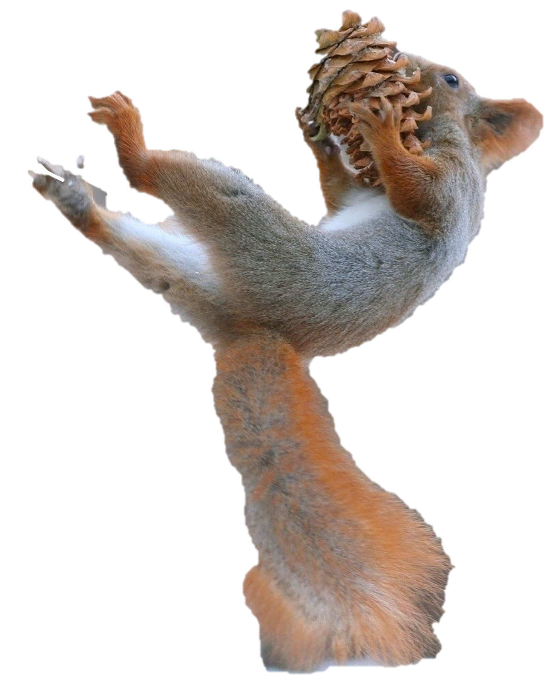
Changes Since Beta
Animated models
Bug fixing for multiplayer
New skybox and lighting
HUD Changes
Gameplay tweaks
Hitbox adjustments
Tutorialisation

Slide 4
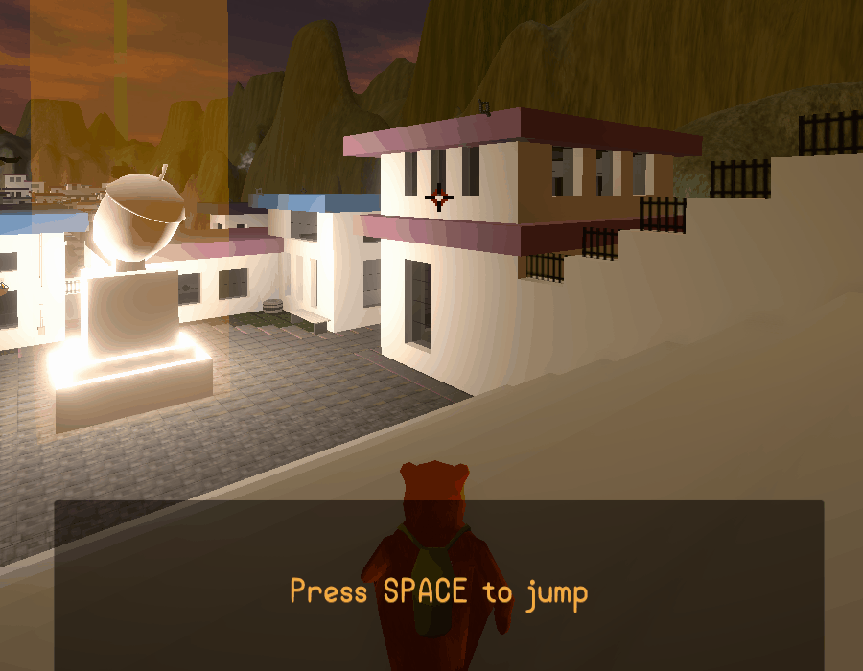
Animated Models
Low poly model adapted
Animations created for –
Starting
Gameplay
Running
Jumping
Gliding
Grappling
Idle

Slide 5

Bug Fixing
Network bugs
Joining/playing the game
Latency issues
Etc.
Gameplay bugs
Animation states
Camera issues
Grapple points
Etc.

Slide 6
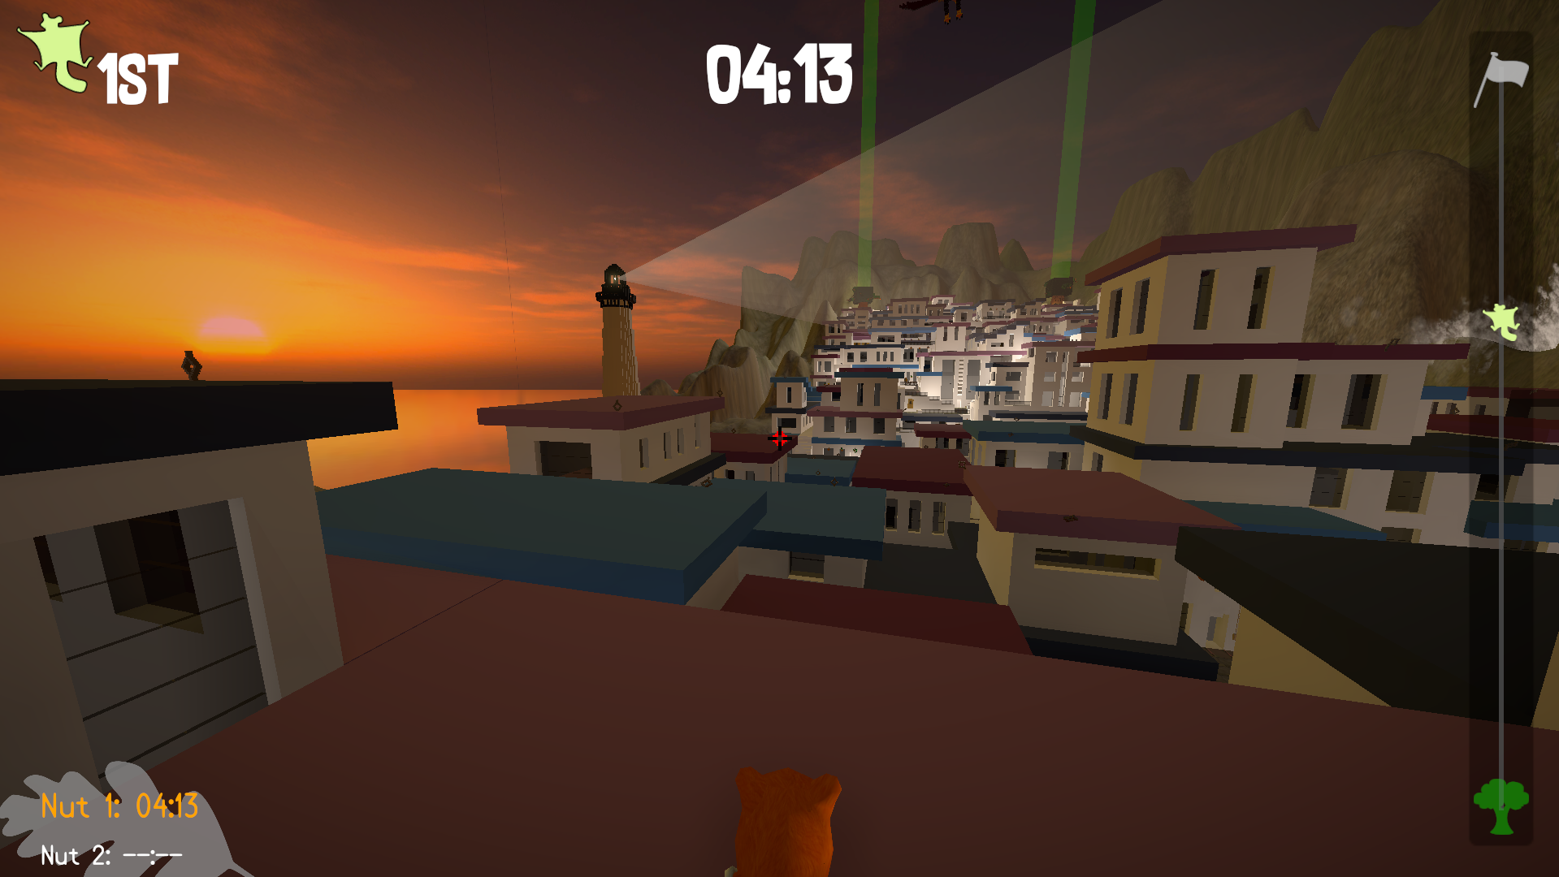
New Skybox, Lighting and HUD

Slide 7
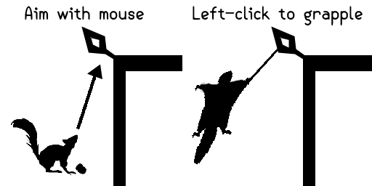

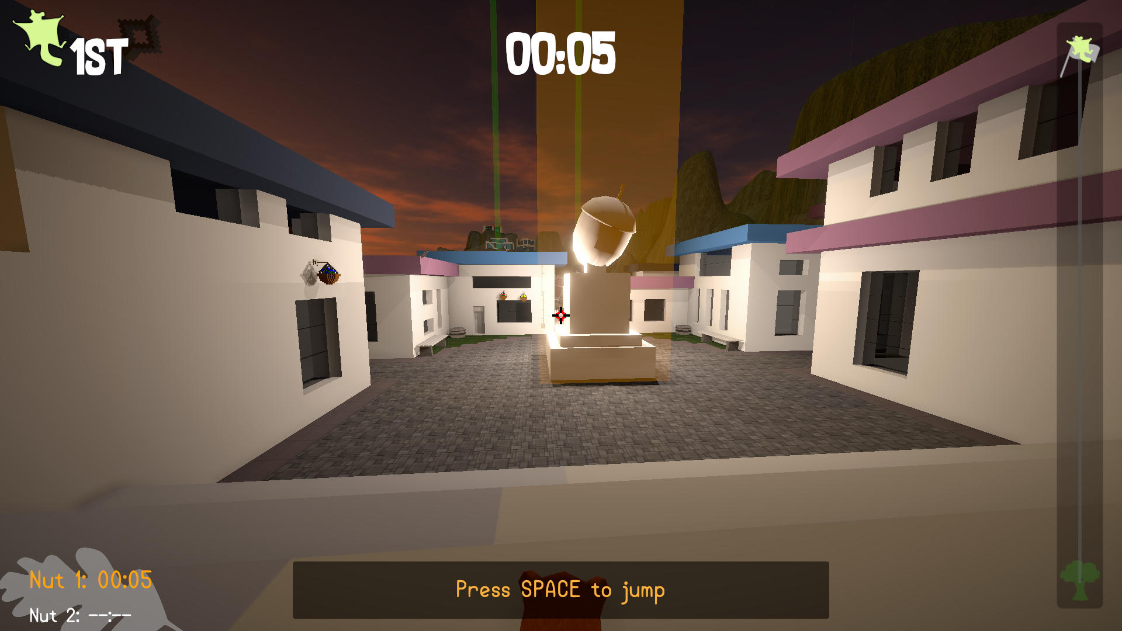
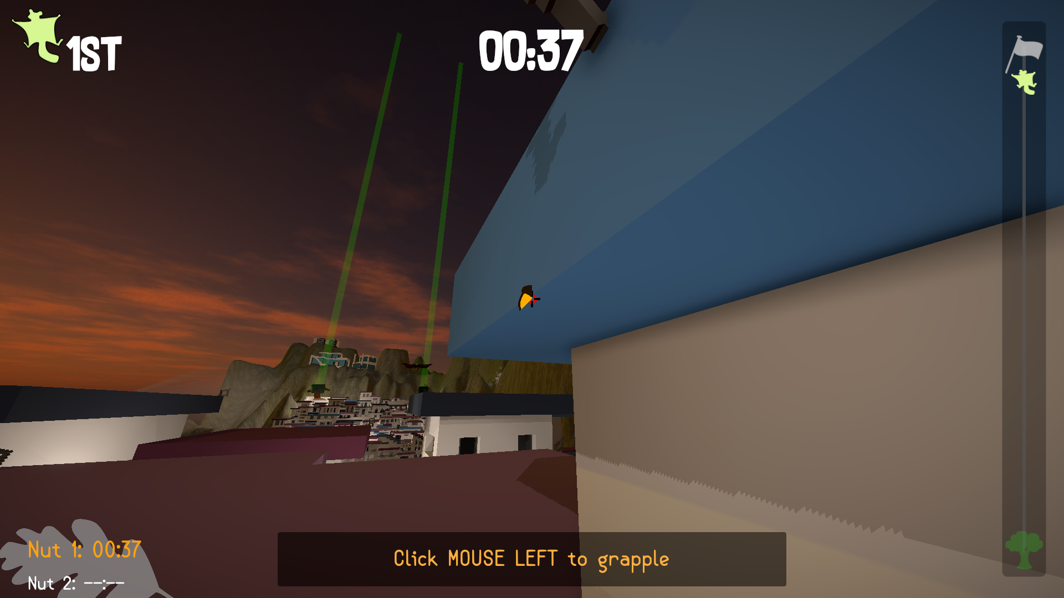
Tutorialisation

Slide 8
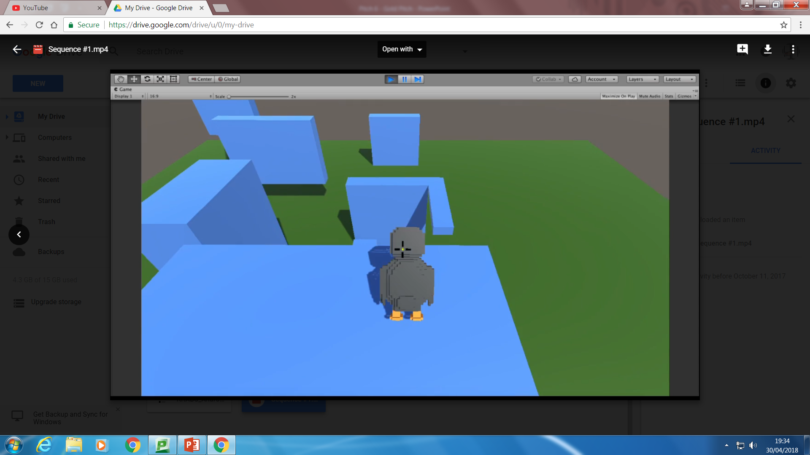
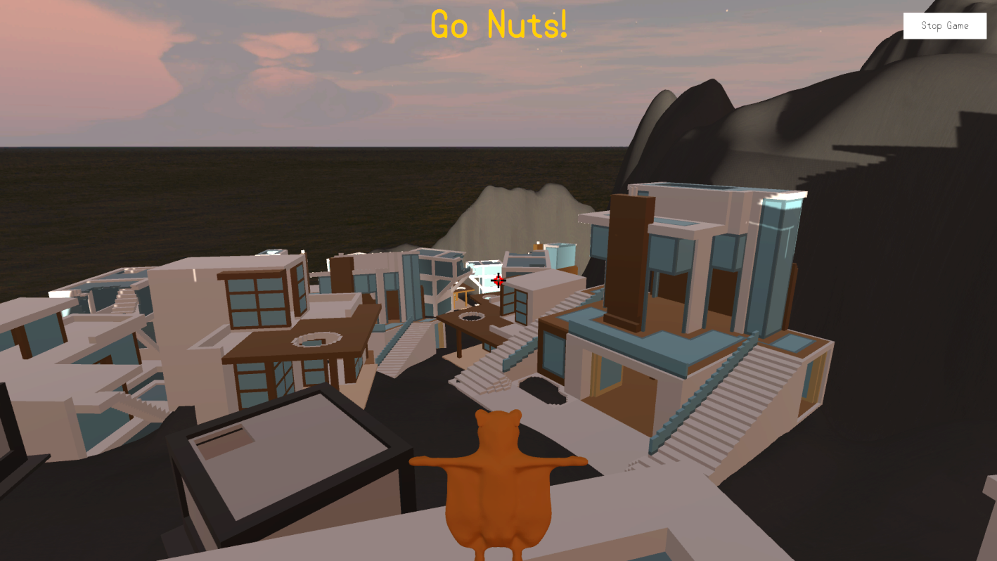
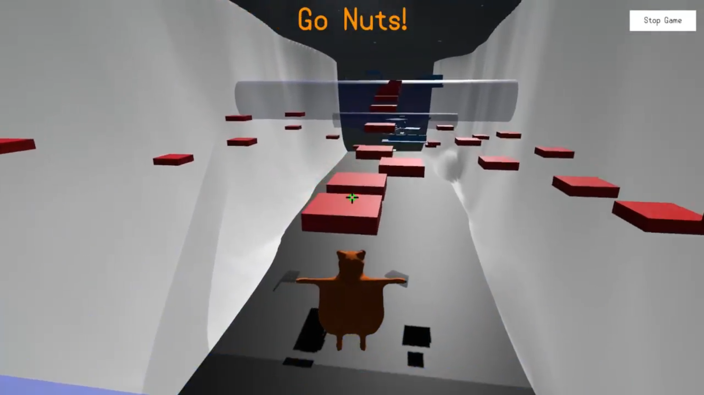
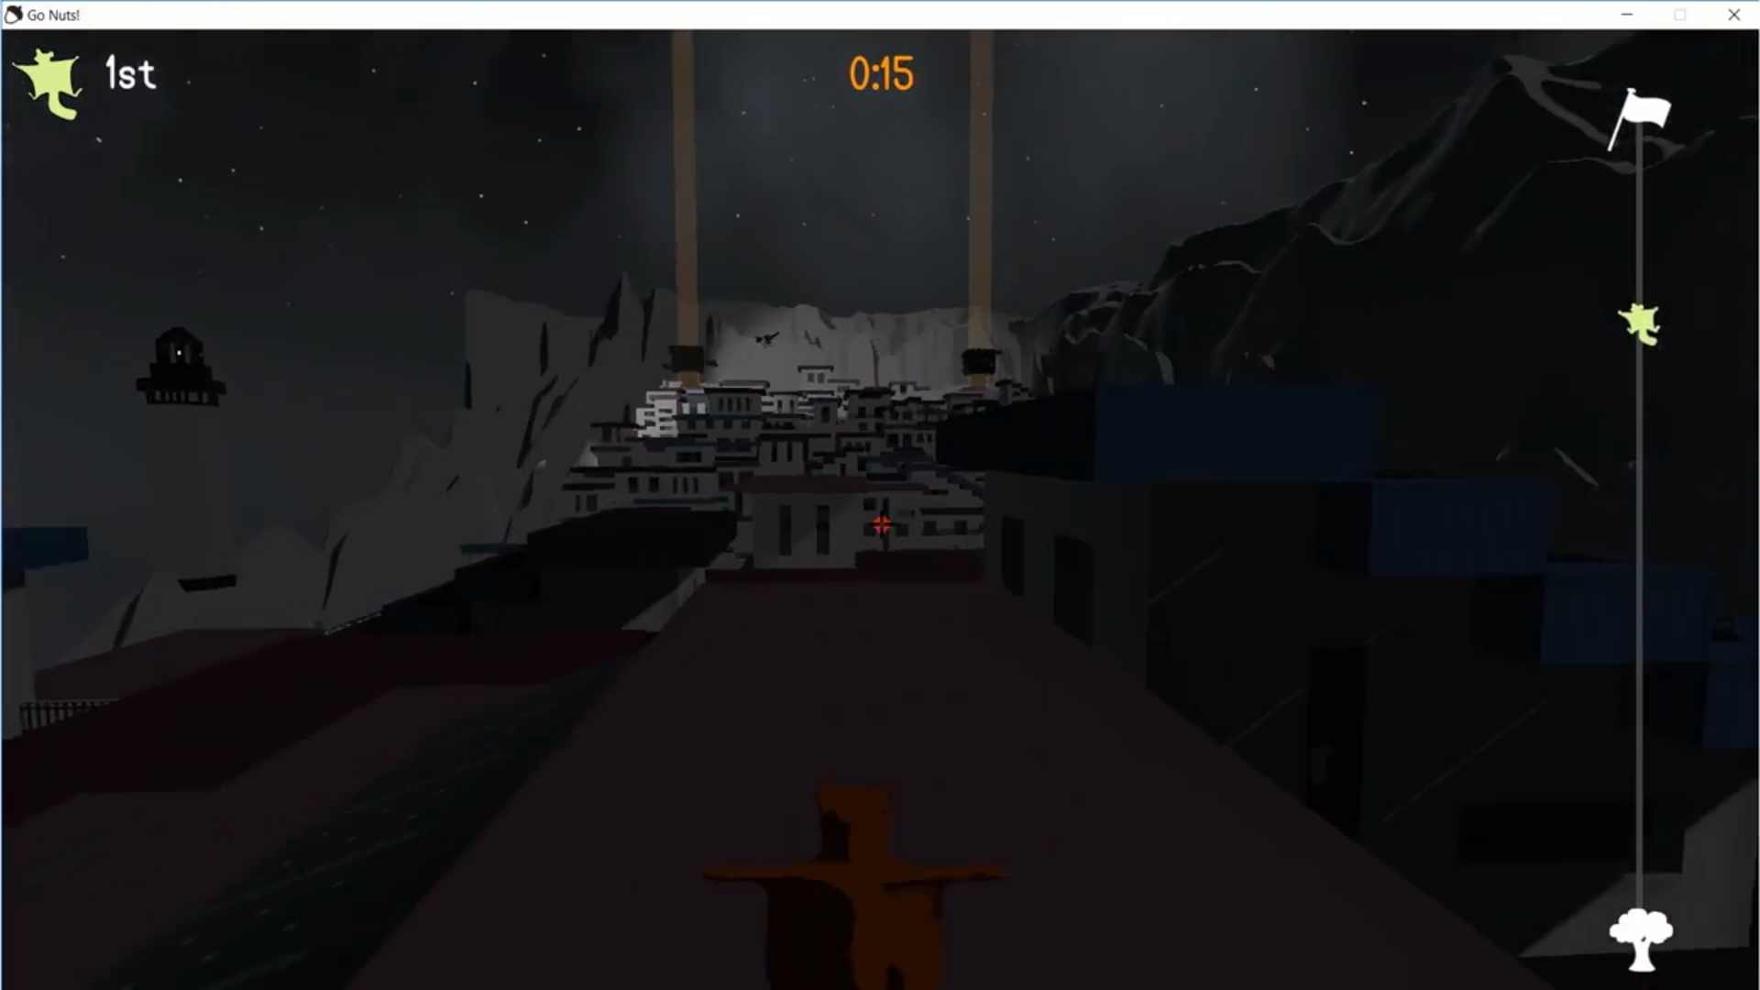
Iteration... Iteration… Iteration…

Slide 9
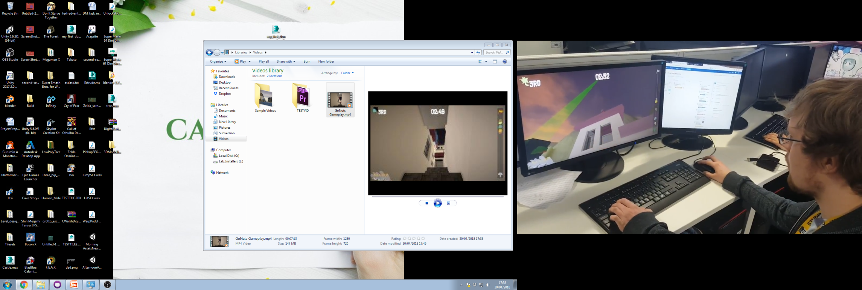
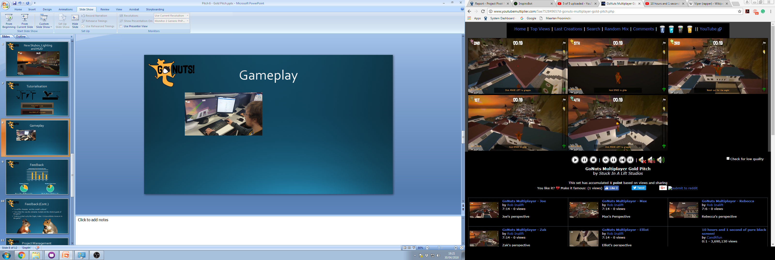
Gameplay

Slide 10
Feedback

Slide 11


Feedback (Cont.)
“Loved the character and the overall outlook.”
“I also liked the way the obstacles looked and the distinct goals of the game.”
“Everything makes sense to me when I play”

Slide 12
Project Management
Hours Worked
Rebecca | 184h 56m
Elliot | 139h 25m
Max | 90h 30m
Zach | 82h
Joe | 56h

Slide 13
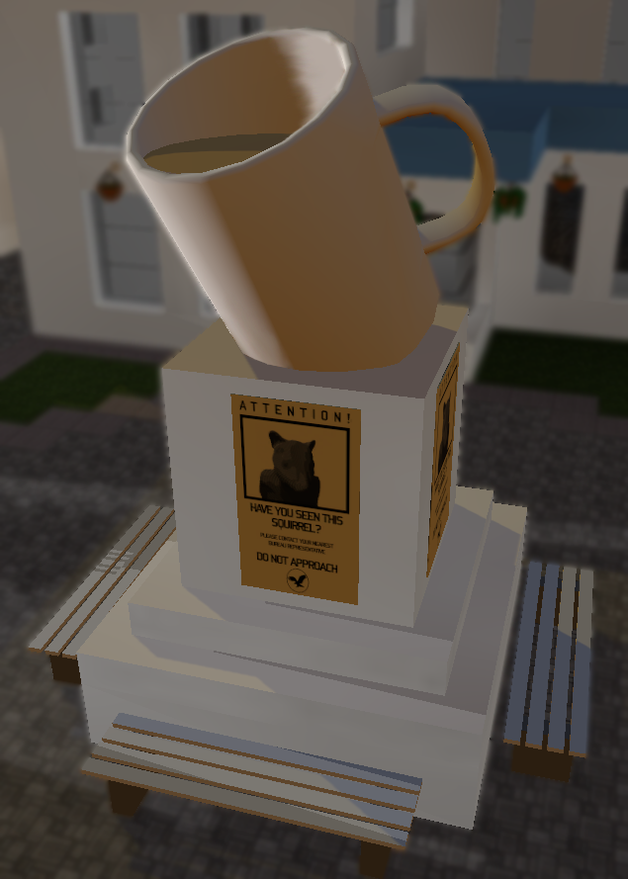
Questions?
Elliot Page – Max Carter – Zachari Cooper – Rebecca Brannum – Joe Wilson

